Slide 1
AI-Augmented Software Development Life Cycle
SEZG534
Akshaya Ganesan
CSIS, WILP

Slide 2
Contact Session: 7 – Fundamentals of AI

Slide 3
Prompt Engineering Vs Finetuning
Prompt-based techniques, which include prompt engineering, adapt a
model without updating the model weights.
Finetuning, on the other hand, requires updating model weights.

Slide 4
Prompt vs Context vs Harness
Feature | The Prompt | The Context | The Harness
What it is | The task or question. | The reference material. | The testing machinery.
Target Audience | The LLM. | The LLM. | The AI Engineer.
Where it lives | User input or application logic. | System instructions or Vector Database. | CI/CD pipeline or local testing suite.
Goal | Get the right answer right now. | Prevent hallucinations. | Prove the system works at scale.

Slide 5
AI Engineering Versus ML Engineering
With traditional ML engineering, you usually start with gathering data and training a model.
Building the product comes last.
However, with AI models readily available today, it’s possible to start with building the product first, and only invest in data and models once the product shows promise
In traditional ML engineering, model development and product
development are often disjointed processes.

Slide 6
Model Context Protocol (MCP)
MCP (Model Context Protocol) is an open-source standard for connecting AI applications to external systems.
Using MCP, AI applications like Claude or ChatGPT can connect to data sources (e.g. local files, databases), tools (e.g. search engines, calculators) and workflows (e.g. specialized prompts) enabling them to access key information and perform tasks.
Think of MCP like a USB-C port for AI applications.

Slide 7
Model Context Protocol (MCP)
MCP follows a client-server architecture
The key participants in the MCP architecture are:
MCP Host: The AI application that coordinates and manages one or multiple MCP clients
MCP Client: A component that maintains a connection to an MCP server and obtains context from an MCP server for the MCP host to use
MCP Server: A program that provides context to MCP clients
The transport layer uses JSON-RPC 2.0 messages to communicate between the client and server, mainly through two transport methods:
  Standard input/output (stdio): Works well for local resources, offering fast, synchronous message transmission
  Server-sent events (SSE): Preferred for remote resources, allowing efficient, real-time data streaming

Slide 8
How does the MCP work?
At its core, the Model Context Protocol allows an LLM to request help from external tools to answer a query or complete a task. Imagine you ask an AI assistant: "Find the latest sales report in our database and email it to my manager."
Here is a simplified look at how MCP would handle this:
Request and tool discovery: The LLM understands it cannot access a database or send emails on its own. It uses the MCP client to search for available tools, where it finds two relevant tools registered on MCP servers: a database_query tool and an email_sender tool.
Tool invocation: The LLM generates a structured request to use these tools. First, it calls the database_query tool, specifying the report name. The MCP client then sends this request to the appropriate MCP server.
External action and data return: The MCP server receives the request, translates it into a secure SQL query for the company's database, and retrieves the sales report. It then formats this data and sends it back to the LLM.
Second action and response generation: Now equipped with the report data, the LLM calls the email_sender tool, providing the manager's email address and the report content. After the email is sent, the MCP server confirms the action was completed.
Final confirmation: The LLM provides a final response to you: "I have found the latest sales report and emailed it to your manager."

Slide 9
Three Layers of the AI Stack
There are three layers to any AI application stack: application development, model development, and infrastructure.

Slide 10
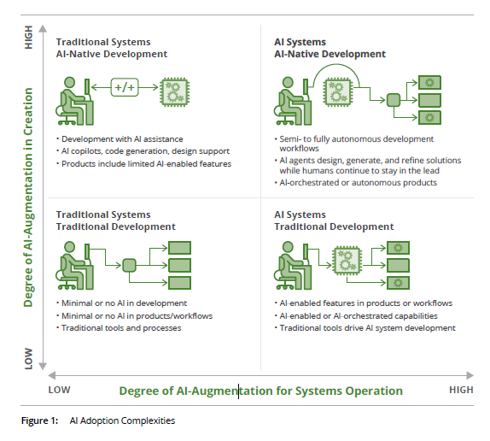
The AI Complexity Matrix
Ref:"The AI Adoption Maturity Model v1.0: Transforming Organizations Through AI", developed by the Carnegie Mellon University (CMU) Software Engineering Institute (SEI)

Slide 11
Engineering AI-Enabled Systems
The software lifecycle changes significantly when machine learning components are introduced, primarily driven by data centricity.
AI systems introduce intense probabilistic uncertainty, our existing software design techniques are essential starting points.
Today, security, usability, and privacy are among the many other mainstream architectural concerns.
The true difference lies in the quality attributes we must prioritize and design for (such as explainability, data centricity, verifiability, and change propagation).
Invest in systems, not just models: Shift the focus away from the "hype curve" of raw model generation toward building the broader software engineering infrastructures that wrap, constrain, and safeguard these probabilistic components

Slide 12
References
https://ieeexplore.ieee.org/stamp/stamp.jsp?tp=&arnumber=9121629
https://cloud.google.com/discover/what-is-prompt-engineering

Slide 13
Thank you

